Slide 1
COVID-19 and Ethnicity
A qualitative exploration of the first wave of the pandemic

Slide 2
*We couldn’t identify with the national commentary on ethnicity
“I mean I don’t consider myself a poor person, you know, I’m educated, I have a degree, I have a job, I’m well paid, so is my partner so we don’t struggle, we don’t get free school meals, we live in a three-bedroom house, we own it, it’s ours. So even people like me were still dying so it wasn’t all this ‘well we all live in overcrowded houses’ because we don’t...”
^Kayla
*The ethnically diverse qualitative team at the Strategy Unit
^Participant in the qualitative study (names have been changed)
The Strategy Unit
Notes:
We’ve dedicated a whole week to health inequalities, exploring what that means for women, for the homeless, for children and young people mental health.
This with regards to ethnicity and COVID-19 became personal.
As the data of the disproportion impact of COVID began to emerge – two things struck me:
Many family members are in the high risk category
There’s some very lazy assumptions being made as to the reason why outcomes were worse- and the quote here from Kayla (one of our interviewees) illustrates this.
Lots of work emerged and is beginning to emerge on this but we felt what was missing was the individual stories of the people we are and how we experienced the pandemic
And crucially, we had the skills to understand the knowledge gap and the support to do something about it - how lucky am I!

Slide 3
We spoke to…..
Name* | Household (Adults and Children) | Ethnicity | Hospital Admission | Bereavement | Residence (region) | Occupation(s) | Date of Interview
Ali | 2A 2C | Middle Eastern, White, Mixed | No | No | Merseyside | NHS - Managerial | 15/06/2020
Bilkis | 4A 3C | Indian, Pakistani, Mixed | No | No | Lancashire | Social Worker, Accountant, Health Care Assistant, Take-away worker | 18/06/2020
Cassim | 2A 2C | Pakistani | No | No | West Midlands | Local Authority | 19/06/2020
Dawood | 5A 3C | Bangladeshi | Yes | Yes | West Midlands | Retired, Self-employed – Small business owner | 22/06/2020
Eshan | 3A | Indian | No | No | West Midlands | Consultant Surgeon, GP | 22/06/2020
Fatima | 4A 2C | Indian | No | No | Greater Manchester | Stay at home mum, Local Authority, Engineering apprenticies | 23/06/2020
Grace | 2A 2C | Black | No | No | London | NHS Primary Care – Non-clinical | 02/07/2020
Hanif | 4A | Pakistani | No | No | West Midlands | Take-away worker, Nursery Assistant | 24/06/2020
Ismail | 2A | Indian | Yes | No | Lancashire | Taxi Driver, Housewife | 20/07/2020
Jamila | 4A 2C | Pakistani | No | No | West Midlands | NHS Admin and Catering | 09/08/2020
Kayla | 1A 2C | Black | Yes | No | London | Nurse | 19/08/2020
*Pseudonyms have been used
The Strategy Unit
Notes:
All had COVID (some not confirmed because of the lack of testing in the initial period) in their household – ranging in severity
Individuals related the story of their household,
3 people were hospitalised, one had a household member that died in hospital.
Many worked for the NHS not necessarily clinical or public sector.

Slide 4
We discussed…
Household/
Family
Infection control
Extended family dynamics
Occupational
Exposure to virus
Equality at work
Community
Safety and cultural connection
Changed cohesion
Access/use of health services
Denial of symptoms
Personal networks
Avoidance due to fear
GP-NHS 111 dynamic
Policy and guidelines
Confusing guidelines
Delayed lockdown
Expectation of poor health
Collective trauma
Systemic racism
Post-COVID health
Urgent Care
Bereavement
We asked about these
Responses related to these

Slide 5
National Policy: Value And Visibility
There was a consensus that lockdown was too little, too late. Borders could’ve been closed earlier, rules could have been enforced better to capitalise on lockdown.
National guidance was confusing; daily briefings became ‘a load of rubbish’; different social distancing rules for different communities (garden visits not allowed but pub ok) were frustrating. Trust in the government was lost and as a result adherence to social distancing rules.
There was anger and frustration that many of the inequalities based on racism, deprivation, gender and the intersectionality of those were known and not acted on.
“I can’t make my mind up whether it’s because of the information, but I do feel that if things had locked down a bit more sooner then I don’t think so many people would have passed away.“
Fatima
"In terms of the official guidance that was given it was very confusing, it wasn’t cohesive – and it ignored swathes of people that would have been disproportionately impacted by COVID. I personally felt that the official guidance was not being created with the science and the evidence that was available. It felt very – and it still does – feel very economy based, not people based”
Grace
The Strategy Unit

Slide 6
Occupation: Risks and Representation
Most identified primary route of COVID-19 infection in their household to be related to a family member’s occupation (followed by school, social and health services exposure)
Those working within the NHS described poor team/organisation management of risk or support and linked these with broader lack of ethnic representation at senior levels.
“I started to take it seriously when my eldest daughter got sent home from work in March before lockdown. Her office had to be deep cleaned as somebody had tested positive for corona after travelling abroad. Two days later she had a fever, her symptoms were mild, but she did have a really bad cough, a high temperature and tiredness.”
Fatima
“The way I was spoken to wasn’t normal, there was an atmosphere and I could tell it was because I’d been off. I was genuinely poorly, I wasn’t making anything up, and then for my managers to be doing that, it was just out of order really. Anybody else that goes off sick, they don’t have that, it’s just towards us Asians.“
Jamila
The Strategy Unit

Slide 7
Community: Connection and Cohesion
A range of residential areas were described in terms of ethnic mix, religion, class, affluence or deprivation. Individuals chose to reside within their communities due to a sense of belonging, safety or access to relevant community spaces, for example mosques.
Pandemic and lockdown provided a good opportunity to confirm community values for most, however for some community cohesion was tested when social distancing rules were not adhered to.
“I think you have to compare the people’s professional roles with the ethnicity. Just so you’re not falling into that trap of automatically assuming where BAME people live is because they’re deprived, just because of their choice to live there. In areas of [City] it can be quite deprived, but you get people living or moving there because of the community.”
Ali
“How things have come together has been amazing. There was a hell of a lot of community spirit and I’d hardly ever spoken to my neighbours across the road, in some ways it’s brought communities back together again in a very localised sense.”
Cassem
The Strategy Unit

Slide 8
Community: Perspectives and Perceptions
Where community belonging was core to the individual or family, individual coping mechanism was influenced by wider perspectives of disbelief (initial stages) and fatalism.
Many could point to others who had experienced much worse symptoms and the relentless bad news became overwhelming.
“In regards to the whole thing my dad was just like “don’t worry about it, ’Allah will protect us. If He means us to die then we’ll die, don’t worry about it”.
Cassem
“People don’t understand, you’ve got a fear of your life here. Literally every other day someone passing away, someone that I knew, or someone close to me, someone in the community. I remember thinking when will this stop? I couldn’t bear that anymore. I couldn’t deal with death anymore. It was just a constant, and losing someone that’s personal to you, all those deaths meant so much more. I felt them.“
Dawood
The Strategy Unit

Slide 9
Families: Control and Curtail
Infection control in the household ranged, it was linked to awareness of risk in the first instance (‘just a bit of flu’), individual anxiety (‘disinfect everything coming into the house’) and the ability to isolate in the house when symptomatic.
There was much angst around social distancing in families where household boundaries are blurred, for example when family decision making involves and impacts those living outside of the main household.
There was some expectation of poor health as a consequence of being elderly, and acceptance of being ‘very elderly’ when aged 60+.
“We went from just taking normal life for granted to being in the house, me having to stay in the bedroom, my partner having to look after the children, and obsessive hand washing, clothes changing regime every time he came back in from outside - there was a lot more anxiety around leaving the house, a lot more anxiety around doing normal things like shopping”
Grace
“There’s also been a lot of tension on the extended family WhatsApp group around the relaxing of guidelines, questioning “what about parents and family rights in all this”. My sisters are very much supportive, but a couple of my brothers have not been. Sometimes there’s a bit of teasing by them to say “you’re very official and legal - we can’t go and see you”, we’ve even been called the COVID police!”
Bilkis
The Strategy Unit

Slide 10
Health and Care: Access and Advice
Individuals made use of their own personal networks to seek professional advice and support for their symptoms.
Most who contacted NHS 111 for symptoms were dismissive of the advice given, and turned to prior experience or advice of friends and family for non-medical treatment.
Reluctance to use hospital based services based mainly on fear of suffering alone and having a preference for being at home. Some worried about treatment and safety at hospitals too.
“Because I work in the health service, I know a Director at one of the Hospitals, so I contacted him and I said I’m a bit concerned for my son, I just need some advice. And he was kind enough to give me their top respiratory consultant. He said look don’t worry, the cough can last a long time.”
Ali
“Having seen the previous week when I was in the hospital, having been to the Intensive Care Unit myself [as a doctor], I was just very, very worried of going into the hospital. I know hospitals are fully laden with bacterial, secondary bacterial infections. Everyone was afraid to go to the hospital. I mean I myself was afraid to go into the hospital.“
Ehsan
The Strategy Unit

Slide 11
Health and Care: Urgent and Bereavement
Those who had personal experience of paramedics and hospital services reported good care.
Post-COVID-19 there were additional mental health and wellbeing anxieties, as well as worsening pain issues and for one person, long COVID challenges.
Most knew someone in the family or community that had died from COVID-19. Grieving was especially difficult in the absence of usual religious or cultural practices that were dependent on social interaction.
“The ambulance came within ten minutes and they all had PPE. They just took me in, I had breathing problems. I was the youngest person on the [COVID] ward. There were four people in the ward, I think all over 70. The doctors and nurses, did come often with everything. They put on a mask and clothes and they gave a good service“
Ismail
“Me and my four brothers went [to the funeral] we had to wear the PPE, the gloves, masks, had to wear all those things. There were two kind of volunteers who explained to us how it’s going to happen. We prayed at the graveyard; it was very clinical. There was no one else there, it was just a graveyard. There were no people there. It felt very lonely, like there was just some detachment to it. That didn’t help the grieving process. Everything was very cold, no emotion in it.“
Dawood
The Strategy Unit

Slide 12
To conclude....
“We need to start looking at different ethnic needs on a case by case basis. I think that there are very unique needs from different communities... This BAME approach to research seems to bung everyone together and thinks that there’s a silver bullet”
Grace
When examining inequities in access and inequalities in outcomes:
Don’t make assumptions about population groups
Disaggregate the data by relevant intersectional elements, such as: gender, ethnic sub-group, age/generation, religion, occupation, salary, educational attainment, housing
Think carefully about the labels used
Inform yourself, ask questions about the origins, cultures and lives of the different population groups
Engage relevant communities, if people are ‘hard to reach’ it means we all have to try harder
The Strategy Unit
Notes:
Ethnicity derives from the Greek word ethnos, meaning a nation It reflects a complex, multidimensional and fluid social construct that requires self-identification with one or more of the following:
shared origins or social background
shared culture and traditions that are distinctive and maintained between generations
a common language
In the UK it is also usually a shorthand term for people sharing a distinctive physical appearance, usually skin colour with ancestral origins in Europe, Asia, Africa or the Caribbean.
Ethnicity is diverse and therefore communities too. When we’re looking at ethnicity data for analysis and decision making, I would emphasise that we go beyond the ethnicity, but think about gender, religion and other identities

Slide 13
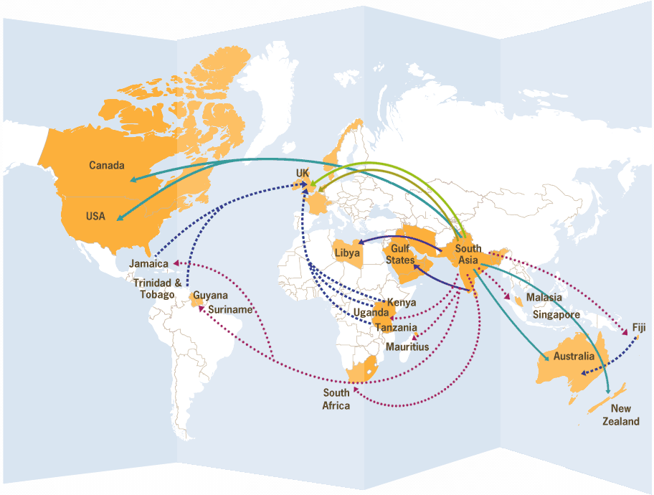
The (South Asian) migration behind the labels
https://www.striking-women.org/page/map-major-south-asian-migration-flows
13
Notes:
Illustrate with south Asian migration example. - a little bit of history

Slide 14
Dr Abeda Mulla
https://www.strategyunitwm.nhs.uk/
@Strategy_Unit
07720 341305
abeda.mulla@nhs.net

